Slide 1

Day 2/3:
Introduction to Python Basics Part 2
MARCH 2024
EPAM Proprietary & Confidential.

Slide 2
Contents
01
Warm-up
02
Questions about homework
03
Print/Input statements
04
Variables and Constants
05
Operators in Python: Assignment, Logical, Arithmetic.
06
How to save and run a Python Script
07
How to install an IDE to use Python (PyCharm Community)
08
GitHub basics+ “How to use” demo
09
How to install an IDE to use Python (PyCharm Community)

Slide 3
Input statement
Imagine you're talking to a computer, and you want to ask it a question, like "What's your name?" or "How old are you?" In Python, the input() statement lets you do just that!
It works like this: When you use the input() statement in your code, Python stops and waits for you to type something on the keyboard.
Whatever you type is like your answer to the computer's question. Then, Python takes what you typed and stores it so you can use it later.

Slide 4
Input statement
Here's how you use the input() statement:
So, when you run this code, Python will ask you "What's your name?" on the screen. Once you type your name and press Enter, Python will save that data value (your name) in that variable called `name`
name = input("What's your name? ")

Slide 5
Print statement
Now, let's say you want to talk back to the computer and tell it something. That's where the print() statement comes in handy!
The print() statement is like talking to the computer. You can use it to make the computer display messages or show you the results of calculations.

Slide 6
Print statement
Here's how you use the print() statement:
When you run this code, Python will show `Hello, world!` on the screen
You can also use print() to display the value of variables, like this:
print("Hello World!")
print("Hello, my name is ", name)

Slide 7
Input/Print statements
So, with input() you ask the computer questions, and with print() you tell it things or show results on the screen. It's like having a conversation with the computer!
name = input("What's your name? ") print("Hello, " + name + "!") age = input("How old are you?") print("Cool, " + name + "It is a pleasure talk to a" + age + " years old person.")

Slide 8
Input/Print statements
name = input("What's your name? ") print("Hello, " + name + "!") age = int(input("How old are you? ")) print("You will be", age + 1, "years old next year.") message = "Enter three numbers separated by spaces:" num1, num2, num3 = input(message).split() total = int(num1) + int(num2) + int(num3) print("The total is:", total)

Slide 9
Input/Print statements
name, age, ps5_price = "John Due", 15, 350.85698 print("My name is", name, "and I have", age, "years old") print("My name is " + name + " and I have " + str(age) + " years old") print("My name is {} and I have {} years old".format(name, age)) print(f"My name is {name} and I have {age} years old") print("My PS 5 costs ${:.2f}".format(ps5_price)) print(f"My PS 5 costs ${ps5_price:.2f}") print("apple", "banana", "orange", sep=" <---> ")

Slide 10
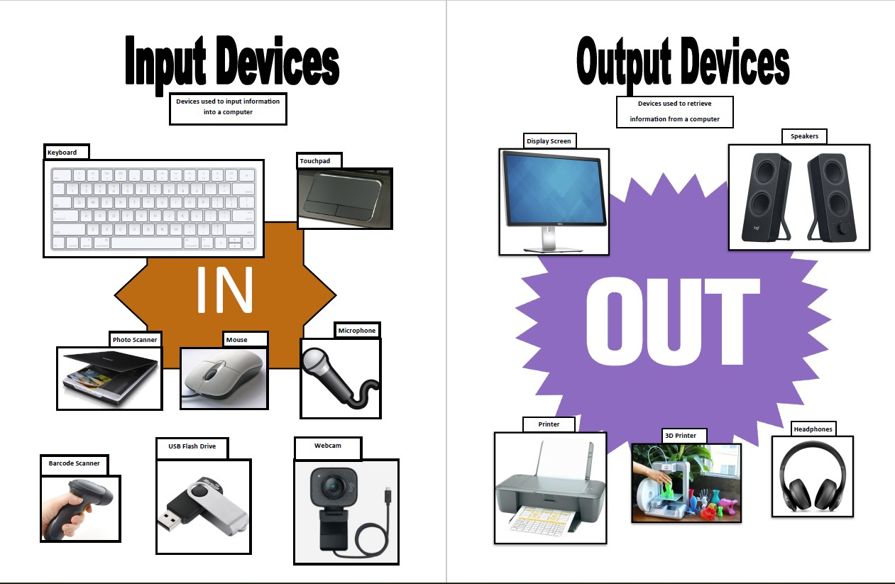

Slide 11
Variables
Imagine you're trying to solve a math problem. Let's say you want to find out how much money you'll have after buying a few items. Now, to keep track of different amounts of money, you would use a piece of paper to write down numbers, right?
Well, in programming, a variable is like that piece of paper. It's a way to store information so you can use it later in your code. But instead of writing numbers on paper, you give a name to your variable, and you can store different kinds of information in it, not just numbers.

Slide 12
Variables
They are simply containers for storing data values
Python has no command for declaring a variable, so you create one the moment you first assign a value to it
For example, if you want to remember someone's name, you can create a variable called "name" and store their name in it. If you want to remember someone's age, you can create a variable called "age" and store their age in it.
Here's how you create a variable in Python:
name = "John" age = 15
Name of the variables
Value of the variables

Slide 13
Variables
first_name = "John" second_name = "Due" first_name = second_name
day_of_birth = 7 month_of_birth = 11 year_of_birth = 2009
one, two, three = 1, 2, 3

Slide 14
Constants
Constants are like variables, but their value doesn't change throughout the program
Imagine you have something that stays the same, like the value of pi (π) in math. It's always the same, right? Constants are used to store such unchanging values.
Here's a simple example using a constant for the value of pi:
PI = 3.14159

Slide 15
Constants
Python programmers follow a convention of using UPPER CASE letters and underscores ("_") to represent constants to make it clear that the value should not be changed
PI = 3.141592653589793 SECONDS_IN_AN_HOUR = 3600 ABSOLUTE_ZERO_IN_CELSIUS = -273.15 BASE_URL = "https://www.epam.com" TOKEN_CHATGPT "12345678-1234-5678-1234-567812345678" USERNAME = "my_user_name" PASSWORD = "12345678 DAYS_OF_WEEK = ["Mon", "Tue", "Wed", "Thu", "Fri", "Sat", "Sun"]

Slide 16
Python Operators
Arithmetic Operators
Operator | Name
+ | Addition
- | Subtraction
* | Multiplication
/ | Division
% | Modulus
// | Floor division
** | Exponentiation

Slide 17
Python Operators
Assignment Operators
Operator | Example
= | x = 5
+= | x += 3 (same as x = x + 3)
-= | x -= 3 (same as x = x - 3)
*= | x *= 3 (same as x = x * 3)
/= | x /= 3 (same as x = x / 3)
%= | x %= 3 (same as x = x % 3)
//= | x //= 3 (same as x = x // 3)
**= | x **= 3 (same as x = x ** 3)

Slide 18
Python Operators
Comparison Operators
Operator | Name
== | Equal
!= | Not Equal
> | Greater Than
< | Less Than
>= | Greater Than or Equal to
<= | Less Than or Equal to

Slide 19
Python Operators
Logical Operators
Operator | Name
and | Returns True if both statements are true
or | Returns True if one of the statements is true
not | Reverse the result, returns False if the result is true

Slide 20
Python Operators
Identity Operators
Operator | Name
is | Returns True if both variables are the same object
is not | Returns True if both variables are not the same object
Membership Operators
Operator | Name
in | Returns True if a sequence with the specified value is present in the object
not in | Returns True if a sequence with the specified value is not present in the object

Slide 21
How to save and run a Python Script
Use always the extension ".py", e.g.: my_script.py
>>> python my_script.py
Module in Python is a file with Python code

Slide 22
How to install an IDE to use Python (PyCharm Community)
The steps how to install PyCharm Community you can find in Presentation Day 1 (in Google classroom)
There are other IDE that can be used:
Visual Studio (or VS Code)
Atom
Eclipse
Eric, and others.
If you don't want to use PyCharm, feel free to use any of these or others

Slide 23

Git (Version Control System - VCS)
Imagine you and your friends are working together on a big group project, like creating a video game or writing a story.
Now, let's say you're all working on different parts of the project at the same time.
How do you keep track of everyone's changes and make sure you're all working on the same version?
That's where Git comes in!

Slide 24
Git (Version Control System - VCS)
Git is like a magical tool that helps you and your friends work together on projects without stepping on each other's toes

Slide 25
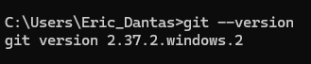
Git (Installation)
Access https://git-scm.com/downloads and download accordingly to your Operational System (Windows, Linux, Mac)
Run the file downloaded
Click on the NEXT buttons till find the INSTALL button
Click on the INSTALL button and wait
After the installation is finished, check if is installed:
Open a Command line (terminal) application
Type: git –version and then hit the enter button

Slide 26

GitHub (Hosting Platform)
Imagine you've written a fantastic story with your friends using Git, but now you want to share it with the world or maybe even get feedback from other people.
That's where GitHub comes in!
GitHub is like a giant library where you can store your projects and collaborate with people from all over the world.

Slide 27
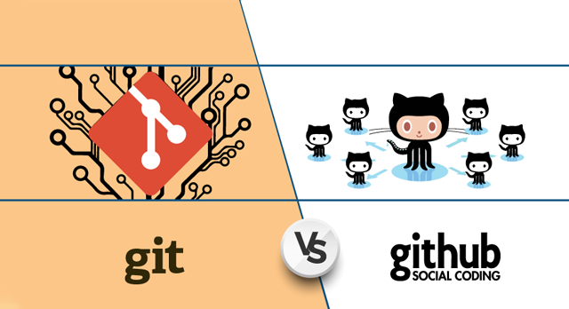
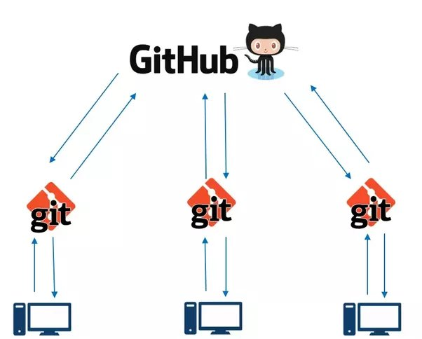
Git is the tool that helps you manage changes in your project locally on your computer.
GitHub is the online platform where you can store your Git projects, collaborate with others, and showcase your work to the world.

Slide 28
GitHub (Setup – Create an Account)
Note: Before work with GitHub, make sure Git is already installed
Access the link https://github.com/ and create an account by clicking on the Sign Up button (top right on the screen)
Type your email and click on the Continue button
Create a password and click on the Continue button
Type a username and click on the Continue button
Click on the Continue button to complete
Verify your account by clicking on the Verify button. After that, you need to solve the puzzle. The puzzle can vary in methods to solve
GitHub will send an 8 numbers code to your email. Copy it and type inside the squares shown by GitHub. If the code is correct, you will be redirected to your GitHub space. Everything is done!

Slide 29
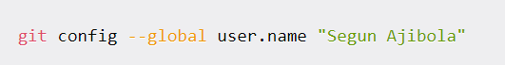
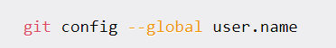
Git (Setting)
From a terminal (command line), set your username:
Confirm that your username is set:
Set your email:
You will be asked to authenticate your GitHub account, so just sign in with the same email to confirm

Slide 30
Git (Download the project from GitHub)
Open a terminal from a folder where you want to have your project
Right-click mouse
Click on Open in Terminal
Type the next commands
`git clone` is like making a copy of a project from GitHub onto your computer
git clone https://github.com/ericrommel/ekids.git (in general)
git clone git@github.com:ericrommel/ekids.git (only if you have defined a public SSH key)
Go to the folder where you cloned the project and have fun!

Slide 31
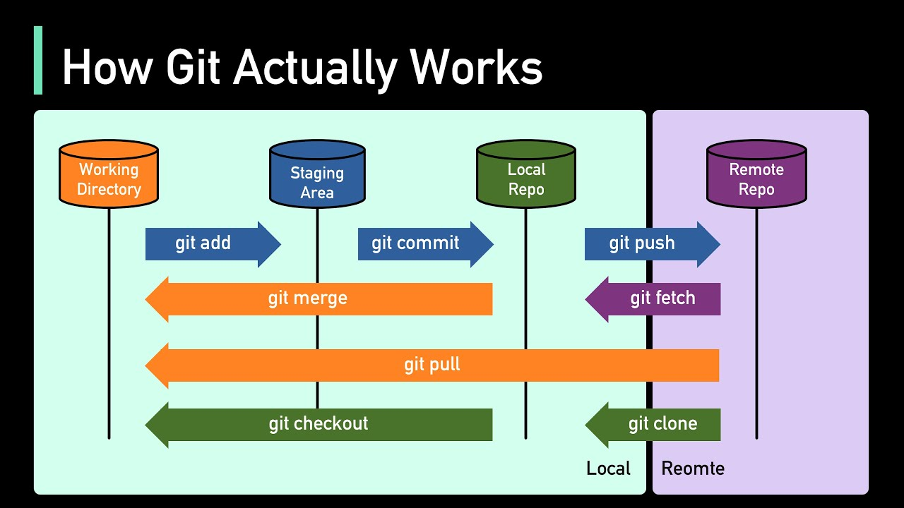
Git (Main commands)

Slide 32
Git (Main commands)
Change to the main branch
git checkout main
Pull the up to date files from Github
git pull
Change to your branch
git checkout my-branch-name-here
Merge the changes from remote to your local
git merge main
See what files were changed
git status
Add files that you want to save on Git
git add file-name or git add .
Commit your changes
git commit –m "A nice message to understand what was done"
Push your changes
git push

Slide 33
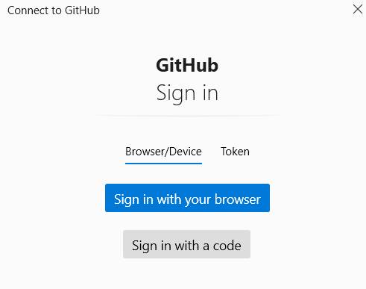
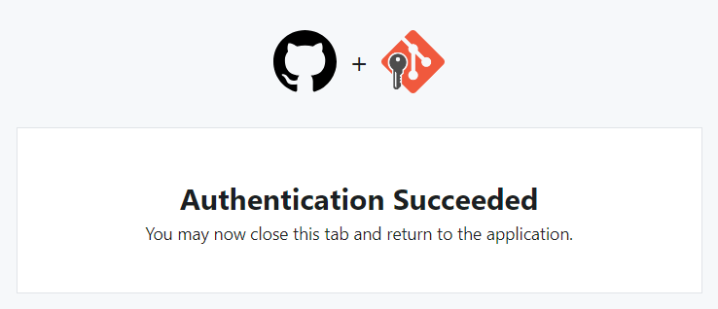
Fix Git/GitHub Integration
If you cloned using https://github.com/ericrommel/ekids.git
Before pushing your changes, log in to your GitHub account in a browser
After that, push your changes
git push
You should be prompted to log in using the browser access, just confirm it

Slide 34
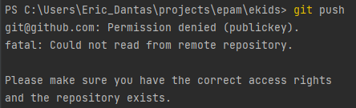
Fix Git/GitHub Integration
If the below message is appearing for you:
You need to follow the next slide steps (use Git Bash terminal)
See that the issue is with the public key.
Probably you don’t have it saved in your machine or in your GitHub account

Slide 35
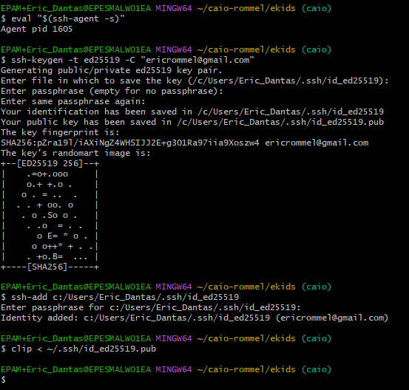
Fix Git/GitHub Integration
1
Turn on ssh-agent
Generate a new SSH key on your local machine (replace to use your email)
Just press Enter
Type a passphrase (don’t forget it)
Re-type the passphrase
Add your SSH key to the ssh-agent
Type your passphrase defined
Copy the SSH public key to your clipboard (memory)
2
4
3
5
6
7
8

Slide 36
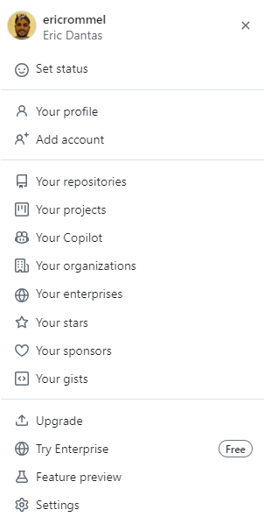
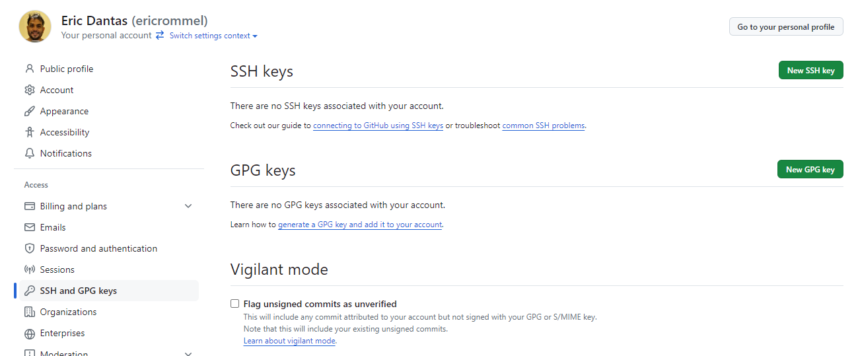
Fix Git/GitHub Integration
Now, go to your GitHub account and save your SSH KEY copied before
3
2
1

Slide 37
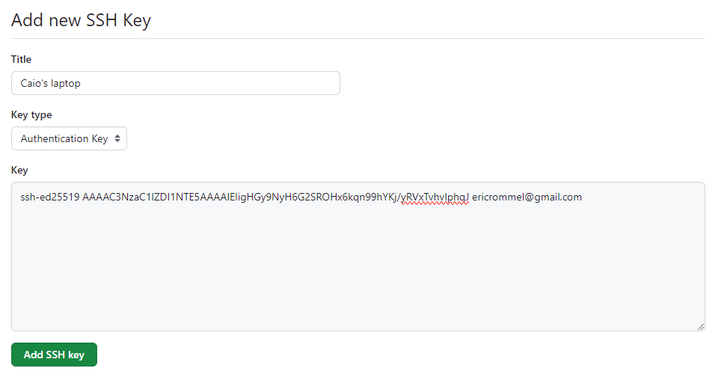
Fix Git/GitHub Integration
Now, go to your GitHub account and save your SSH KEY copied before
Add any title you want for your SSH KEY
Ctrl+V (paste) your SSH KEY saved from Git Bash
After clicking on that button, your SSH KEY is saved. You can go back and push your changes

Slide 38
Homework
Note: Add a screenshot for each completed task below on your Google Classroom
Install PyCharm Community
Install Git
Create a GitHub account
Clone the repository from https://github.com/ericrommel/ekids
Bonus point:
Do the homework available on the repository: https://github.com/ericrommel/ekids/tree/main/homeworks/week-2
After finish the homeworks, send it back to GitHub following the steps:
git add, git commit, git push

Slide 39
Book Python-for-Kids
https://bedford-computing.co.uk/learning/wp-content/uploads/2015/10/Python-for-Kids.pdf

Slide 40
Thank you!

